Slide 1

MCTV LTD Presentation
20th of April
Presented by:
Ciara O’Donoghue,
Alex Jimborean,
and Tudor Constantin,
Wojtek Hordyniec

Slide 2
Agenda
Alex Jimborean
Overview
Introduction to MCTV
- Gantt Chart
User Reports and guides
Importance of branding
UML chart
Website Demo
Conclusion and findings
Any Questions?

Slide 3
Introduction To MCTV Limited
Ciara 0’Donoghue
MCTV is a family run business.
Turnover of €1 million per annum and 5 staff members.
Owners (Michael and Doreen) aware company needs to move with the times.
Owners put up €100,000 to be spent on technology improvements
Each family member is a manager of a specific department within the business
Each manager assigned the task of convincing the business owners to adopt their chosen technology improvement.

Slide 4
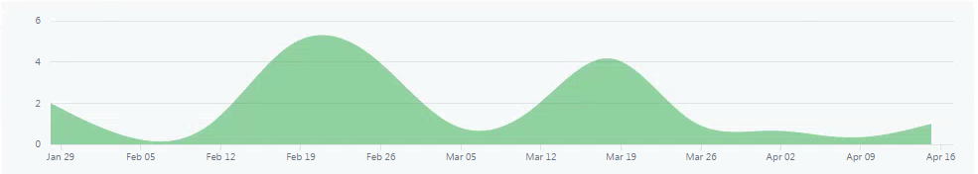
Gantt
Tudor Rupanu
Discussion of a Gantt diagram

Slide 5
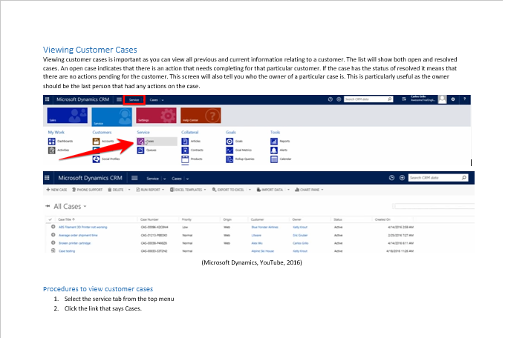
User Reports & User Guides
Ciara 0’Donoghue
Microsoft Dynamics CRM
Explanation of why Dynamics is the best option for MCTV
Comparison between Dynamics and other market leaders
Reasoning for why Derek’s idea is better than the other family members
User guide for basic CRM tasks

Slide 6
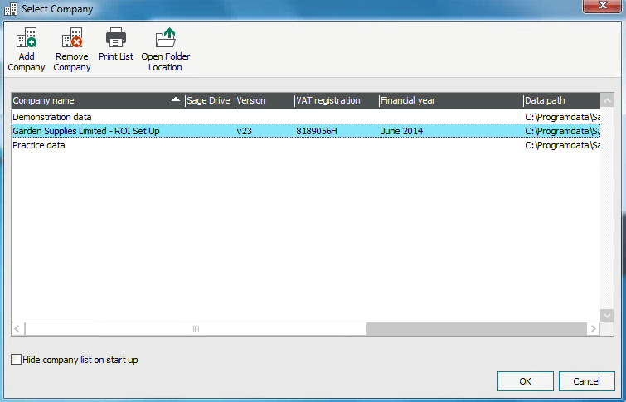
User Reports & User Guides
Alex Jimborean
SAGE
Why its different
Its simplicity
Why Robertas idea is better than the rest

Slide 7
Company Branding – The Importance
Ciara 0’Donoghue
Promotes Recognition
Sets you apart from the competition
Helps customers know what to expect
Connects with customers on an emotional level
Strong branding can generate referrals

Slide 8
Company Branding – Our Colours
Ciara O’Donoghue
Colour increases brand recognition
Blue is seen as calming and constant
Represents a productive and non invasive company
Famous brands in blue:
Facebook
Twitter
Linked In
Skype
Dell

Slide 9
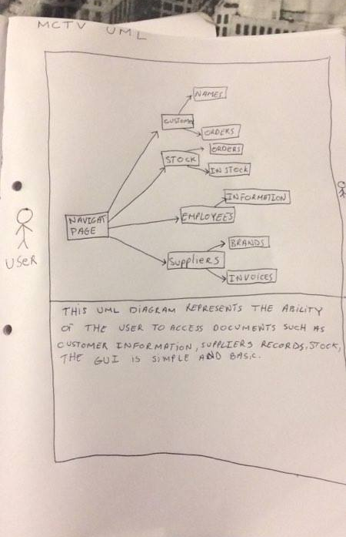
UML
Alex Jimborean
The UML. Hand Drawn,
Simple paths
Explanation of the access for users.

Slide 10
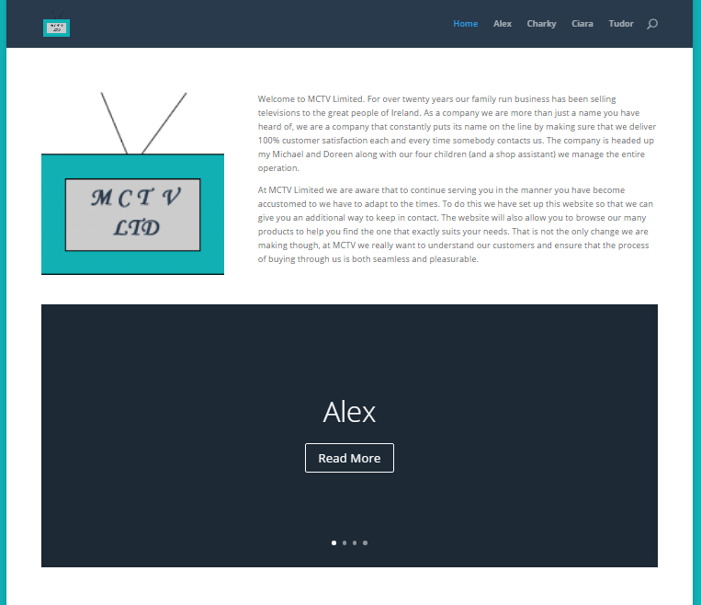
Our Website
Ciara 0’Donoghue
Created the homepage
Designed the layout keeping company colours
Created user logins for other team members
Created and inserted company logo
www.sabproject.host22.com

Slide 11
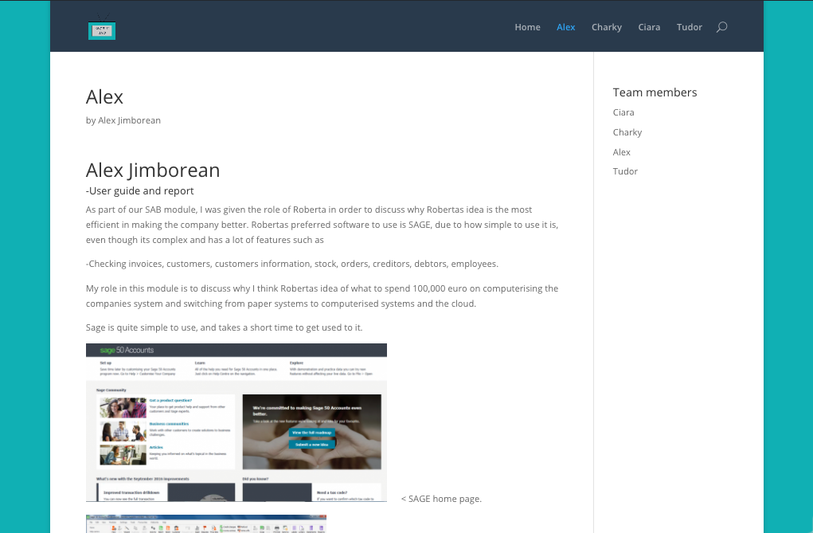
My Wordpress Page
Alex Jimborean
My wordpress page consists of my opinion of Robertas idea
Introduction to sage
My contributions in the group
Images added for visual presentation.

Slide 12
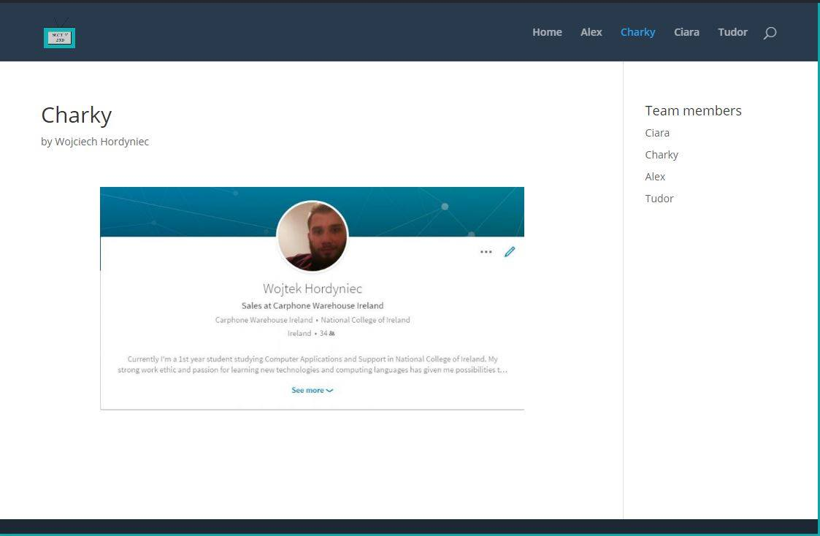
My page
Wojtek Hordniek
My contribution
Why I believe Liams idea is the most profitable for the business.

Slide 13
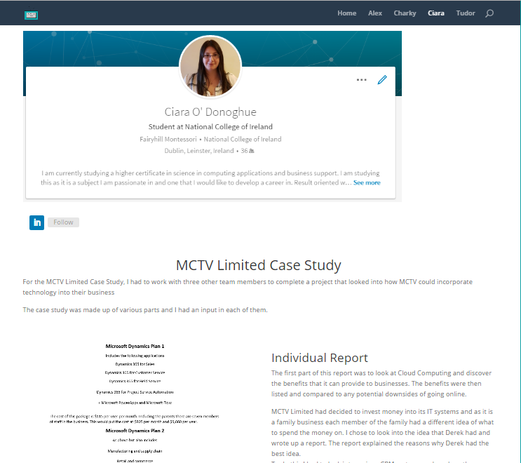
My Page
Ciara 0’Donoghue
Created a post with all my project work on it
Added images from each part of the project
Images move into post as you scroll through it
Added a link through from LinkedIn

Slide 14
Conclusion and Findings
Ciara 0’Donoghue
Future Developments
Open more stores
Increase technology throughout the business as necessary
Increase online presence
Convert all paper records into online records
Keep seeking new suppliers to increase profit margins

Slide 15
Any Questions
Alex
Please feel free to ask any questions you may have.
?

